Slide 1
AoC 2023 – Day 23
Greedy algorithm, Math, DFS, Topological Search
10 Oct. 2025

Slide 2
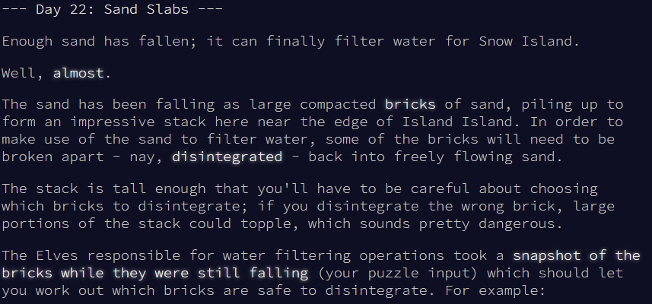
Advent of Code 2023 – Day 22
Link to the task: https://adventofcode.com/2023/day/22

Slide 3
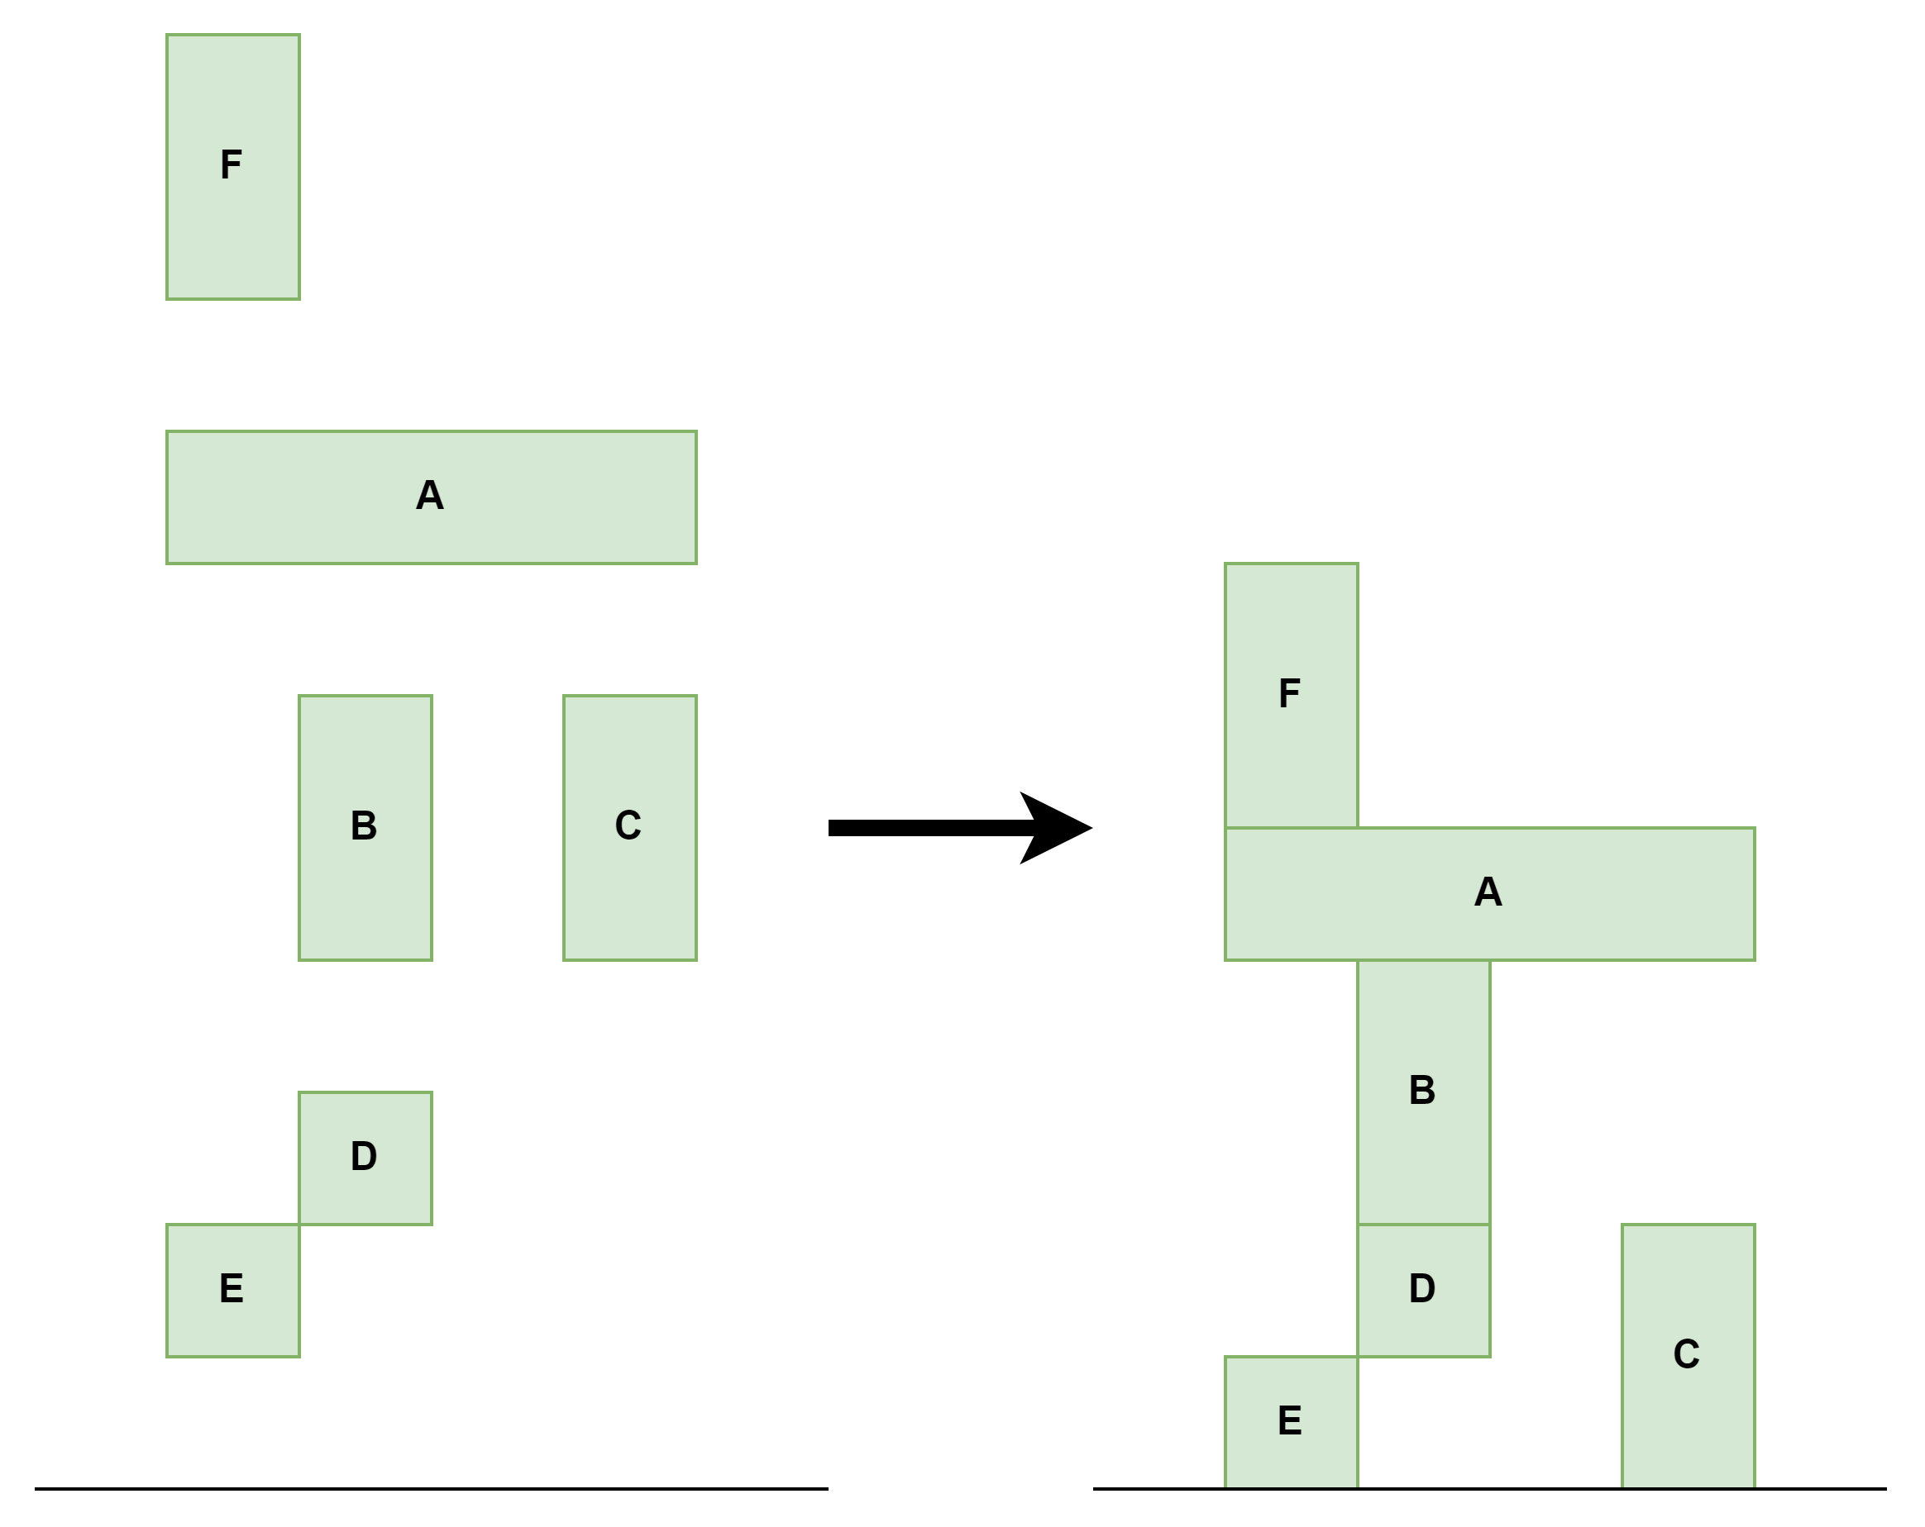
The first step
Consider the first step as a tetris.
2D Example – Easy to Imagine

Slide 4
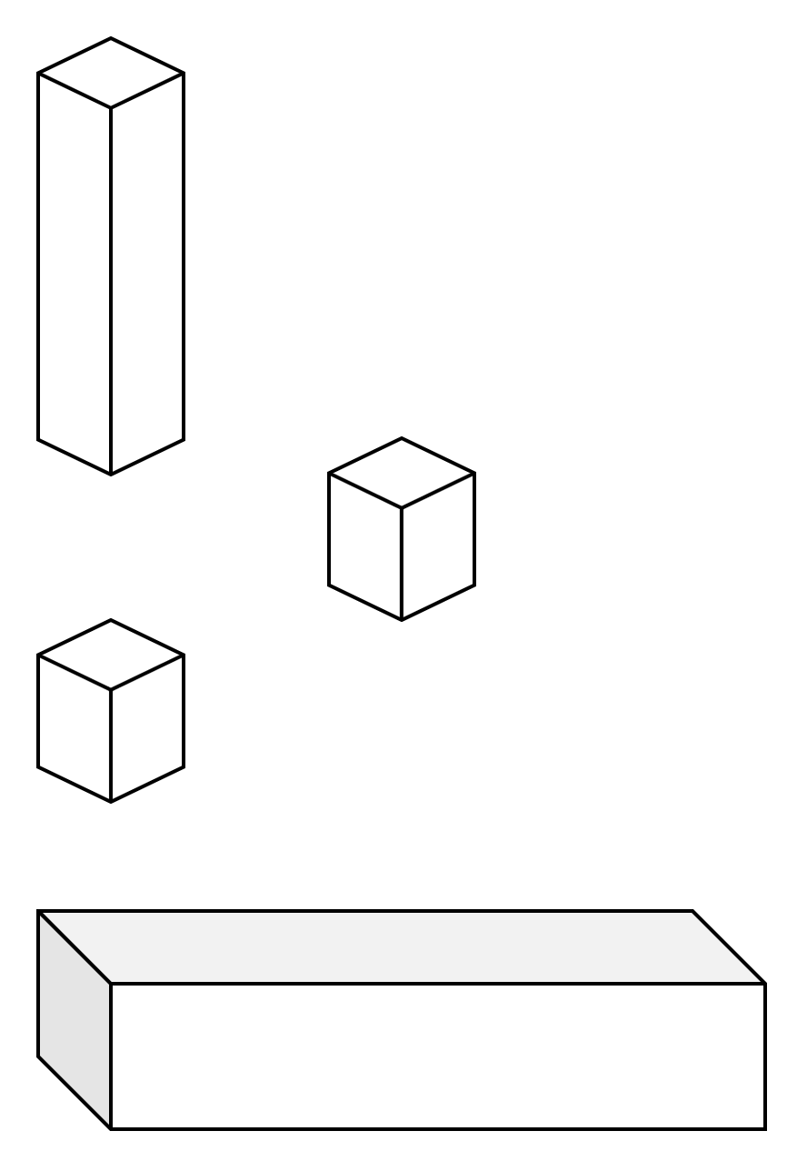
The first step
But consider 3D tetris – this our task. 3D is tough to visualize.

Slide 5
How to Calculate End State?
We do not want to simulate due to a lot of figures, we want to calculate the end state in on run.

Slide 6
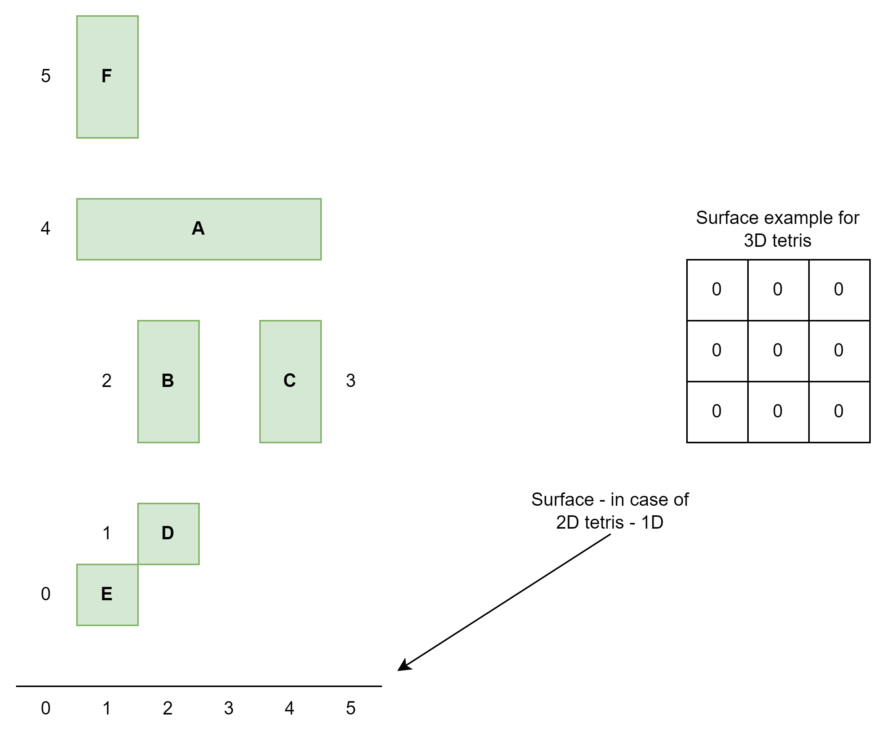
How to Calculate End State
Greedy algorithm
Sort all blocks by Z axis.
Create an array (X, Y) to describe current surface.

Slide 7
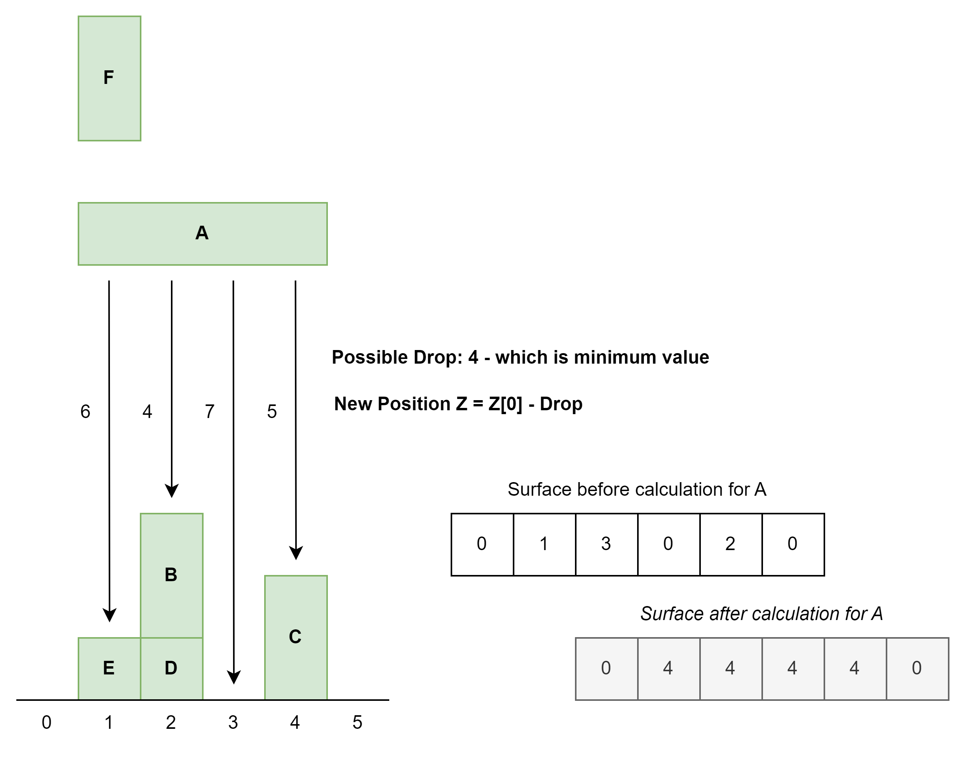
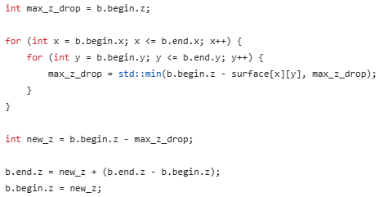
How to Calculate End State
Math
For every block in sorted array calculate its Z position using the surface:

Slide 8
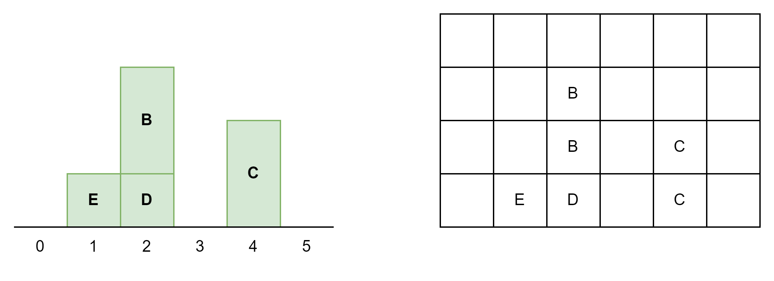
Which blocks can be removed
Breadth First Search
Map blocks on 3D array as in case of visualization.
Run BFS to find BOTTOM neighbors (supporters).

Slide 9
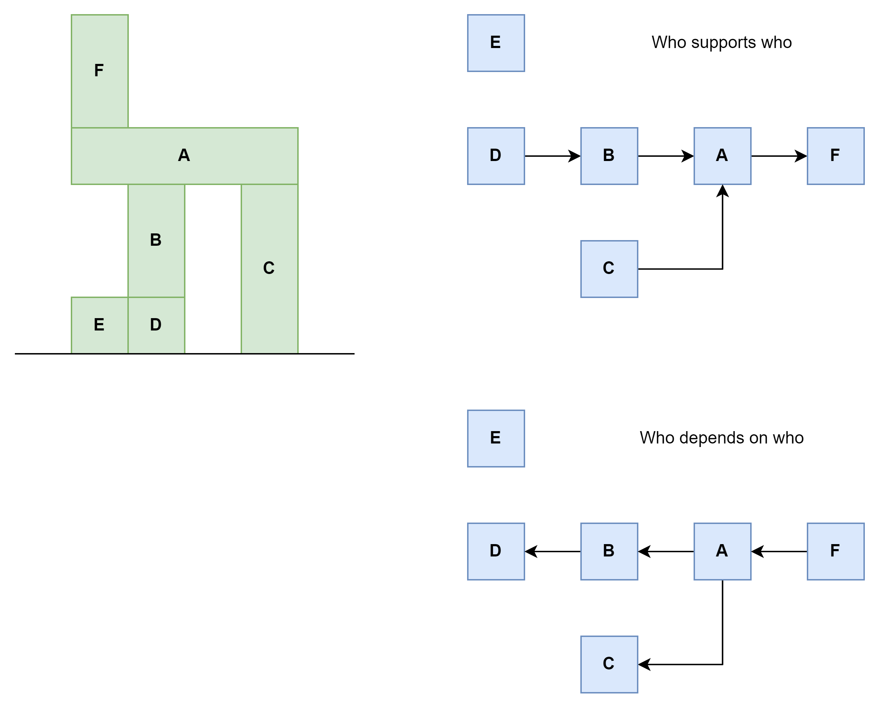
Which blocks can be removed
Breadth First Search
Run BFS to find BOTTOM neighbors (supporters).
Build two Simplified Graph:
Create a graph which defines who depends on who.
Create a graph which defines who supports who.

Slide 10
Which blocks can be removed
Using created graphs, we can say which blocks can be removed:
E – can, doesn’t support anyone
D – cannot
B – can, alternative is C.
C – can, alternative is B.
A – cannot.

Slide 11
Part 2 – Chain Reaction
Disintegrating bricks one at a time isn't going to be fast enough. While it might sound dangerous, what you really need is a chain reaction.
You'll need to figure out the best brick to disintegrate. For each brick, determine how many other bricks would fall if that brick were disintegrated.

Slide 12
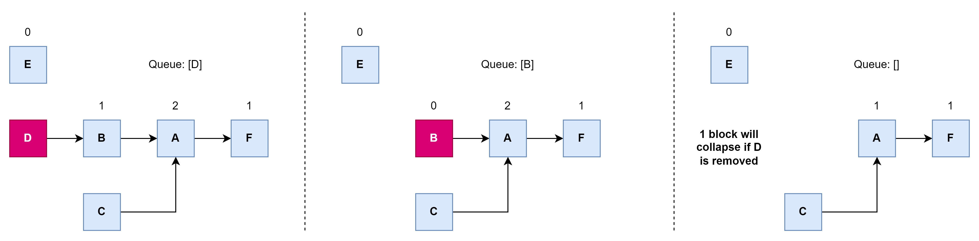
Part 2 – Chain Reaction
Topological Sort with Specific Input
Chain reaction can be efficiently solved for every block using topological sort.

Slide 13
Part 2 – Chain Reaction
Topological Sort.
Initialize total collapse counter.
For every block K:
Run topological sort for block K to count collapsed blocks.
Create an array with incoming connections counter.
Initial queue contains only K block – single element!
Count every removed block (incoming connection counter = 0).
Update total collapse counter.

